Slide 1

reACT JS
the TRUE frontend Library
http://172.16.20.214:5000

Slide 2
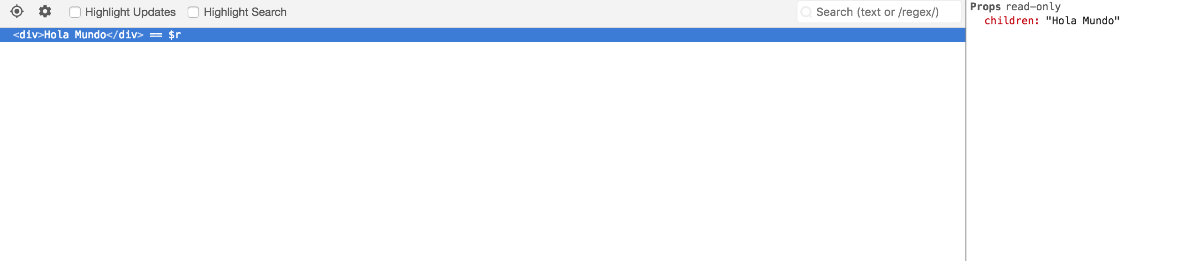

$whoami.
Gonzalo Soriano
Fullstack developer at Tokiota
@aresgonza

Slide 3
about tokiota.
Software company in bcn & madrid
Microsoft technologies
4 departaments
70+ in Barcelona, 20+ in Madrid
Development Infrastructure
Sharepoint
Big Data
@tokiotait

Slide 4
agenda.
what is react & reactdom
state, props and methods
START
01
02
03
general syntax

Slide 5
agenda.
handling user inputs
START
04
05
06
loops and conditionals
lifecycle hooks

Slide 6
agenda.
starting our Marvel app
07
END
08
09
dev tooling
what’s next?

Slide 7
01. what is react & reactdom
Reactjs is a library for building user interfaces.
React can be used as a base in the development of single-page or mobile applications.
However, to create complex applications, it is required to use a composition of various libraries for state management (e.g. Redux), routing, etc.
ReactDom take care as a library to render React elements

Slide 8
01. what is react js

Slide 9
02. general syntax.
import React, { Component } from 'react';
import './App.css';
class App extends Component {
render() {
return (
<div>App</div>
)
}
}
export default App;

Slide 10
03. state, props and methods.
import React, { PureComponent } from 'react';
class App extends PureComponent {
state = {
text: `Hi`,
}
helloMethod = () => {
const { test } = this.props;
const { text } = this.state;
console.log(`${text} - ${test}`);
}
render() {
return (
<div>App</div>
)
}
}
export default App;

Slide 11
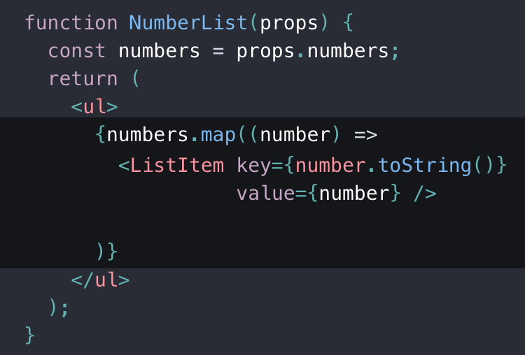
04. loops.

Slide 12
04. conditionals.

Slide 13
06. handling user inputs.
<button onClick=“this.coolFunction”>GO REACT</button>
React events are named using camelCase, rather than lowercase.
onClick onContextMenu onDoubleClick onDrag onDragEnd onDragEnter onDragExit
With JSX you pass a function as the event handler, rather than a string.

Slide 14
07. lifecycle hooks.
getDerivedStateFromProps
getDerivedStateFromProps
getSnapshotBeforeUpdate

Slide 15
08. dev tooling.

Slide 16
09. starting our Marvel app

Slide 17
10. what’s next?

Slide 18


thanks for your attention.
special thanks to @xavism9 for provide the slides!

